Slide 1
Signal Encoding Techniques
Chapter 6

Slide 2
Reasons for Choosing Encoding Techniques
Digital data, digital signal
  Equipment less complex and expensive than digital-to-analog modulation equipment
Analog data, digital signal
  Permits use of modern digital transmission and switching equipment

Slide 3
Reasons for Choosing Encoding Techniques
Digital data, analog signal
  Some transmission media will only propagate analog signals
  E.g., optical fiber and unguided media
Analog data, analog signal
  Analog data in electrical form can be transmitted easily and cheaply
  Done with voice transmission over voice-grade lines

Slide 4
Signal Encoding Criteria
What determines how successful a receiver will be in interpreting an incoming signal?
  Signal-to-noise ratio
  Data rate
  Bandwidth
An increase in data rate increases bit error rate
An increase in SNR decreases bit error rate
An increase in bandwidth allows an increase in data rate

Slide 5
Factors Used to Compare
Encoding Schemes
Signal spectrum
  With lack of high-frequency components, less bandwidth required
  With no dc component, ac coupling via transformer possible
  Transfer function of a channel is worse near band edges
Clocking
  Ease of determining beginning and end of each bit position

Slide 6
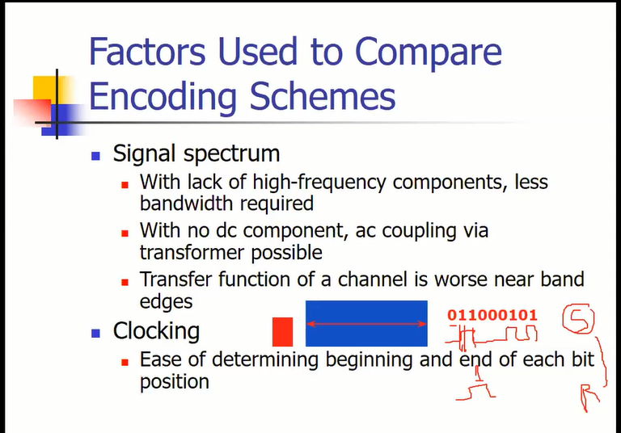

Slide 7
Factors Used to Compare
Encoding Schemes
Signal interference and noise immunity
  Performance in the presence of noise
Cost and complexity
  The higher the signal rate to achieve a given data rate, the greater the cost

Slide 8
Basic Encoding Techniques
Digital data to analog signal
  Amplitude-shift keying (ASK)
    Amplitude difference of the carrier signal
  Frequency-shift keying (FSK)
    Frequency difference near carrier frequency
  Phase-shift keying (PSK)
    Phase of carrier signal shifted

Slide 9
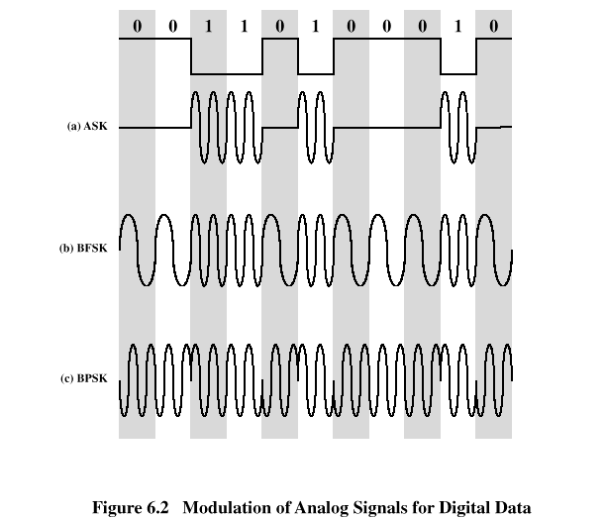
Basic Encoding Techniques

Slide 10
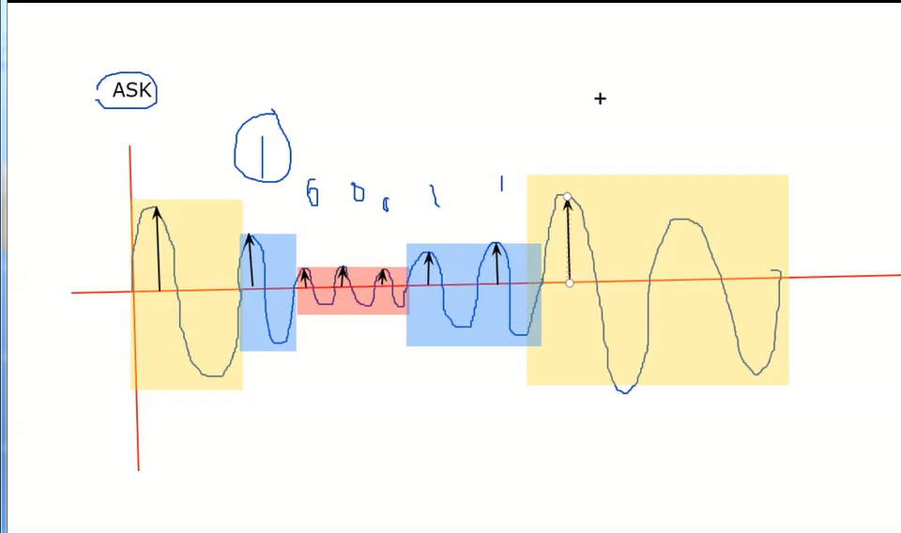



Slide 11
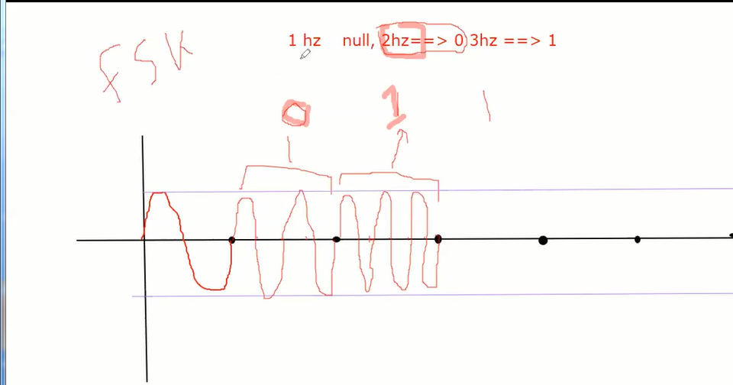

Slide 12
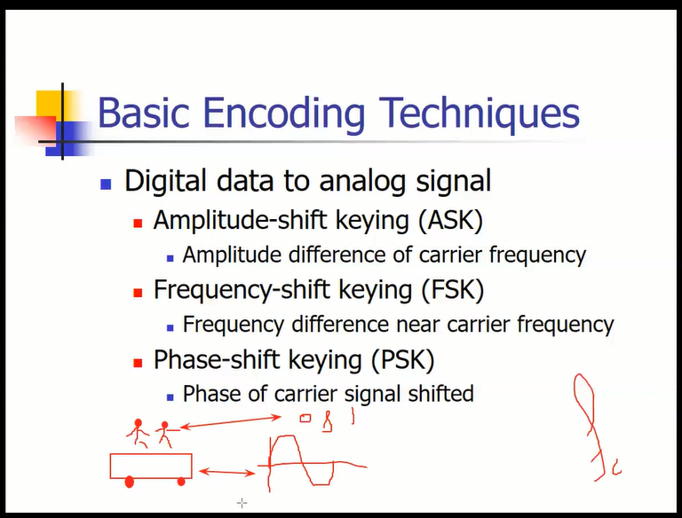

Slide 13
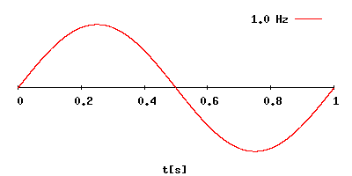
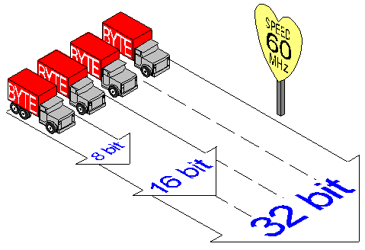
Speed and Width
6-<number>

Slide 14
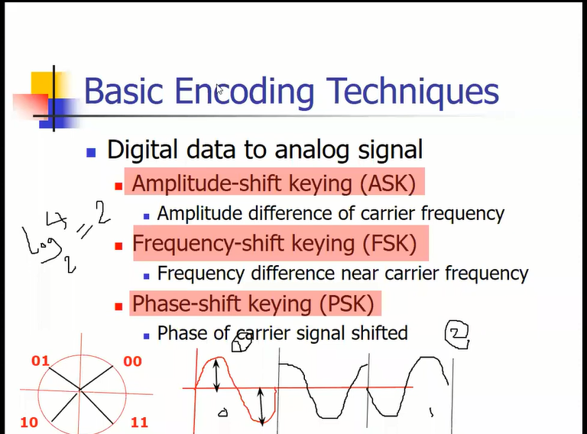

Slide 15
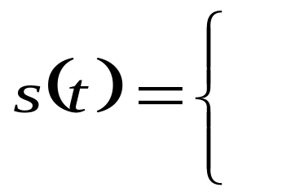
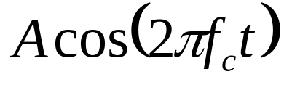


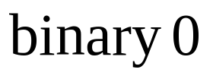
Amplitude-Shift Keying
One binary digit represented by presence of carrier, at constant amplitude
Other binary digit represented by absence of carrier
    where the carrier signal is Acos(2πf_{c}t)

Slide 16
Amplitude-Shift Keying
Susceptible to sudden gain changes
Inefficient modulation technique
On voice-grade lines, used up to 1200 bps
Used to transmit digital data over optical fiber

Slide 17
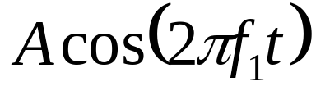
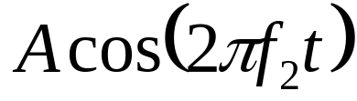
Binary Frequency-Shift Keying (BFSK)
Two binary digits represented by two different frequencies near the carrier frequency
    where f₁ and f₂ are offset from carrier frequency f_{c} by equal but opposite amounts

Slide 18
Binary Frequency-Shift Keying (BFSK)
Less susceptible to error than ASK
On voice-grade lines, used up to 1200bps
Used for high-frequency (3 to 30 MHz) radio transmission
Can be used at higher frequencies on LANs that use coaxial cable

Slide 19
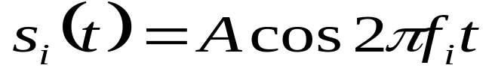

Multiple Frequency-Shift Keying (MFSK)
More than two frequencies are used
More bandwidth efficient but more susceptible to error
    f _{i} = f _{c} + (2i – 1 – M)f _{d}
    f _{c} = the carrier frequency
    f _{d} = the difference frequency
    M = number of different signal elements = 2 ^{L}
    L = number of bits per signal element

Slide 20
Multiple Frequency-Shift Keying (MFSK)
To match data rate of input bit stream, each output signal element is held for:
  T_{s}=LT seconds
    where T is the bit period (data rate = 1/T)
So, one signal element encodes L bits

Slide 21
Multiple Frequency-Shift Keying (MFSK)
Total bandwidth required
  2Mf_{d}
Minimum frequency separation required 2f_{d}=1/T_{s}
Therefore, modulator requires a bandwidth of
  W_{d}=2^{L}/LT=M/T_{s}

Slide 22
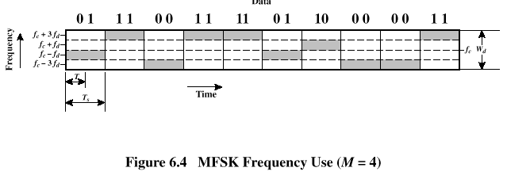
Multiple Frequency-Shift Keying (MFSK)

Slide 23
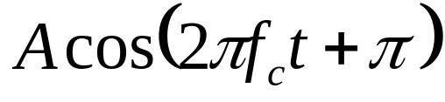
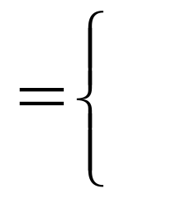
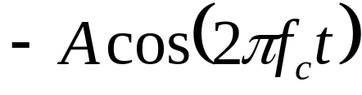
Phase-Shift Keying (PSK)
Two-level PSK (BPSK)
  Uses two phases to represent binary digits

Slide 24
Phase-Shift Keying (PSK)
Differential PSK (DPSK)
  Phase shift with reference to previous bit
    Binary 0 – signal burst of same phase as previous signal burst
    Binary 1 – signal burst of opposite phase to previous signal burst

Slide 25
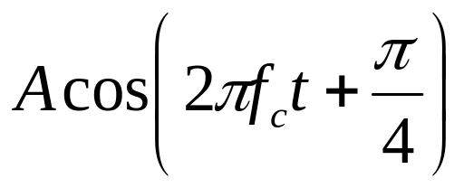
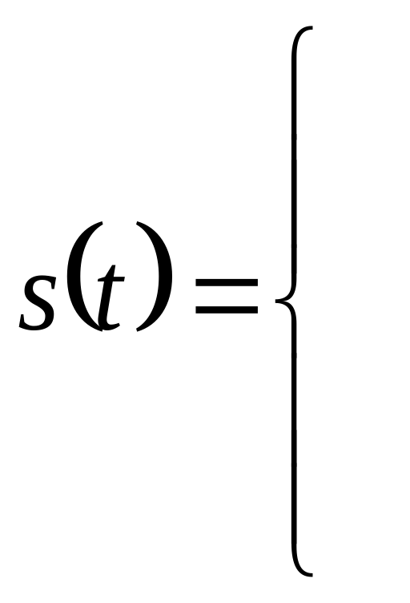

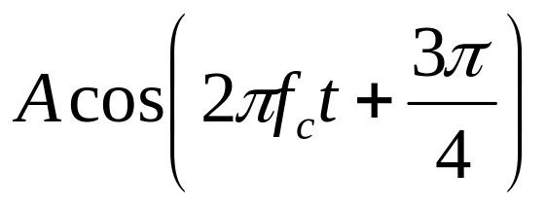

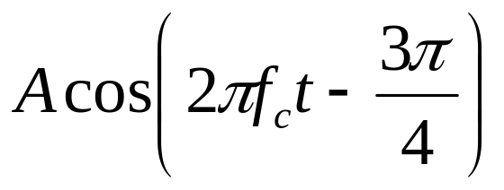

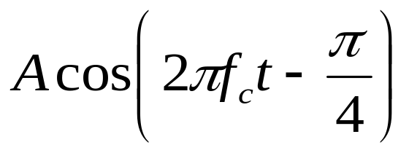

Phase-Shift Keying (PSK)
Four-level PSK (QPSK)
  Each element represents more than one bit

Slide 26
Reasons for Analog Modulation
Modulation of digital signals
  When only analog transmission facilities are available, digital to analog conversion required
Modulation of analog signals
  A higher frequency may be needed for effective transmission
  Modulation permits frequency division multiplexing

Slide 27
Basic Encoding Techniques
Analog data to analog signal
  Amplitude modulation (AM)
  Angle modulation
    Frequency modulation (FM)
    Phase modulation (PM)

Slide 28
Basic Encoding Techniques
Analog data to digital signal
  Pulse code modulation (PCM)
  Delta modulation (DM)

Slide 29
Analog Data to Digital Signal
Once analog data have been converted to digital signals, the digital data:
  can be transmitted using NRZ-L
  can be encoded as a digital signal using a code other than NRZ-L
  can be converted to an analog signal, using previously discussed techniques

Slide 30
TOP 20 MCQ QUESTIONS ON ENCODING AND MODULATION
https://www.siteforinfotech.com/mcq-questions-on-encoding-and-modulation/

Slide 31
TOP 20 MCQ QUESTIONS ON ANTENNAS AND PROPAGATION
https://www.siteforinfotech.com/mcq-questions-on-antennas-and-propagation/

